Slide 1


Internship Assessment

Slide 2
INTERNSHIP DESCRIPTION
Platform :- CodSoft
Domain :- Web Development
Duration :- 4 weeks
(12 august – 12 sept)

Slide 3


Offer letter:
I have completed this online project-based internship program with codsoft. Batch of August, started on 11th of august and completed on 11th of September 2023.

Slide 4
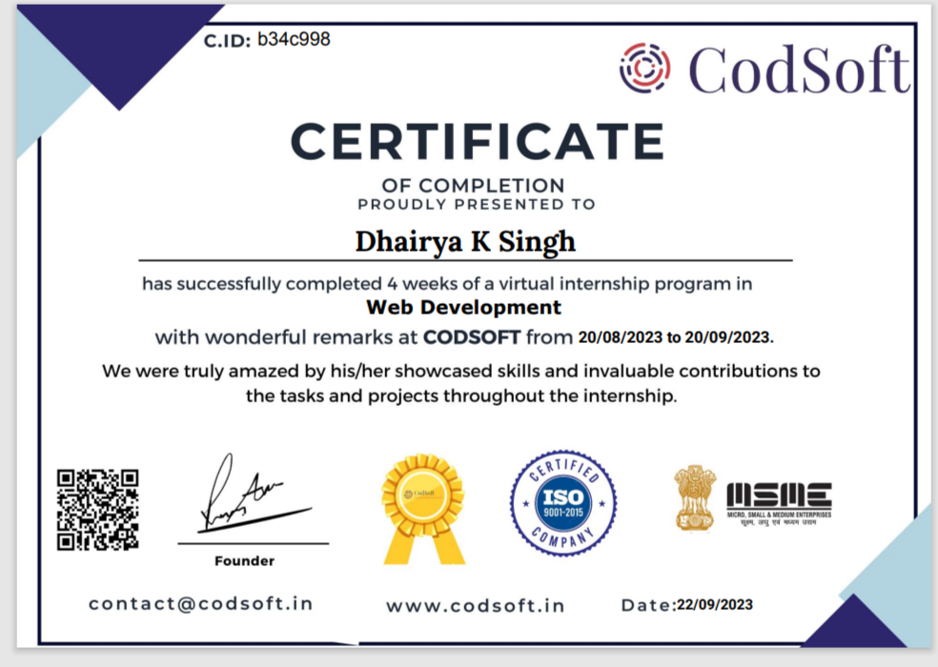
CERTIFICATE OF COMPLETION

Slide 5

Learning:
TOOLS REQUIRED
1
2
3
4
5
HTML
CSS
JavaScript
Projects
Summary

Slide 6


Introduction
HTML and CSS code, we need to test your website, buy domain and hosting, upload files and more. There are also optional things, like SEO, analytics and validation. To help with this process, we may want to look into services that can assist us with creating our website.

Slide 7

HTML
HTML (Hypertext Markup Language) is a text-based approach to describing how content contained within an HTML file is structured. This markup tells a web browser how to display text, images and other forms of multimedia on a webpage.

Slide 8

Advantages Of HTML:
HTML is Browser friendly
Allowed to utilize
Simple to learn
Basic design
Lightweight and quick
Utilization of formats
Information stockpiling

Slide 9

Disadvantages Of HTML:
Static language
Restricted security
Extensive code
Reliance issue
Invests in some opportunity to design

Slide 10

Html5
HTML5 is the latest standard of Hypertext Markup Language, the code that describes the structure and presentation of web pages. It's made up of three codes: HTML, which keeps the structure; CSS, which affects the presentation; and JavaScript, which creates interactive effects within web browsers.

Slide 11

Features:
Simple and secure.
Debugging is simple.
Inbuilt security features.
Less need of plugin.
Graphic design.
Semantic Elements.
Audio and Video Support.

Slide 12

Other Features:
Canvas Elements.
Geolocation API.
Local Storage.
Responsive Images.
Web Workers.
Drag and Drop API.

Slide 13

CSS
CSS stands for Cascading Style Sheets. It is a style sheet language which is used to describe the look and formatting of a document written in markup language. It provides an additional feature to HTML. It is generally used with HTML to change the style of web pages and user interfaces. It can also be used with any kind of XML documents including plain XML, SVG and XUL.

Slide 14

Advantages of CSS:
1. Better Website Speed
2. Easier to Maintain
3. Consistent Design
4. Time-Saving
5. Better Device Compatibility
6. Positioning of Design Elements

Slide 15

Disadvantages Of CSS:
1. Cross-Browser Issues
2. Security Issues
3. Extra Work for Developers
4. Confusion due to many CSS levels

Slide 16

JavaScript
JavaScript is an object-based scripting language which is lightweight and cross-platform.
JavaScript is not a compiled language, but it is a translated language. The JavaScript Translator (embedded in the browser) is responsible for translating the JavaScript code for the web browser.

Slide 17

Advantages Of JS:
Fast speed
Easy to learn
Versatility
Browser Compatible
Server Load
Rich interfaces
Popularity
Regular Updates

Slide 18

Disadvantages Of JS:
Code Visibility
Stop Render
No Multiple Inheritance

Slide 19
Projects
Portfolio
Landing page
Calculator
I have created a localhost website which is presenting about me, my certifications, etc. I have tried my best to create a functional and error free website. It took eight hours of coding.
I have created a raw landing page for coffee. A landing page is a standalone web page, created specifically for a marketing or advertising campaign.
I have also created a simple calculator using my web development knowledge.

Slide 20
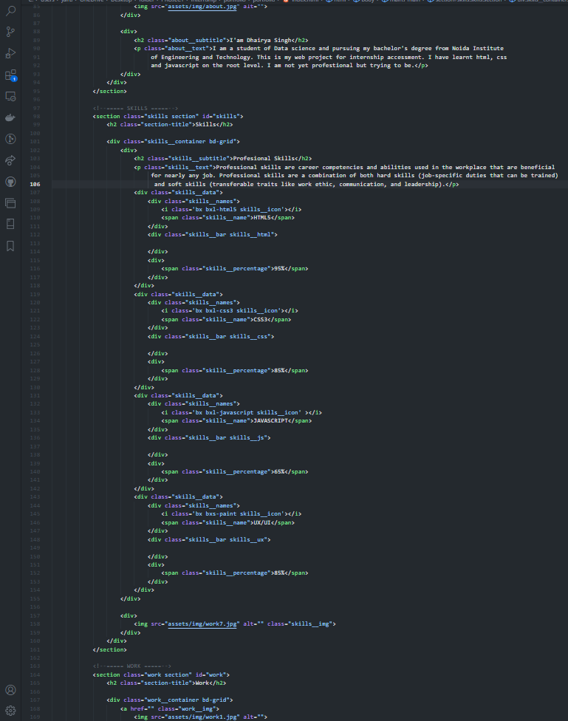
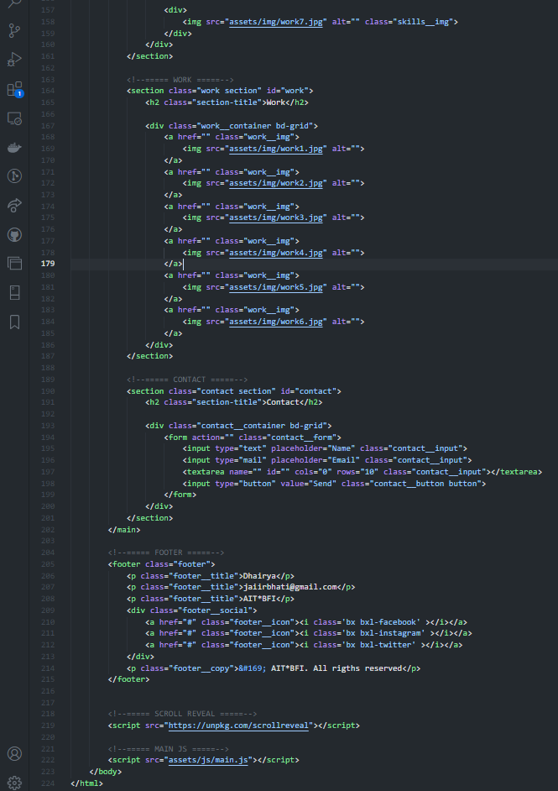
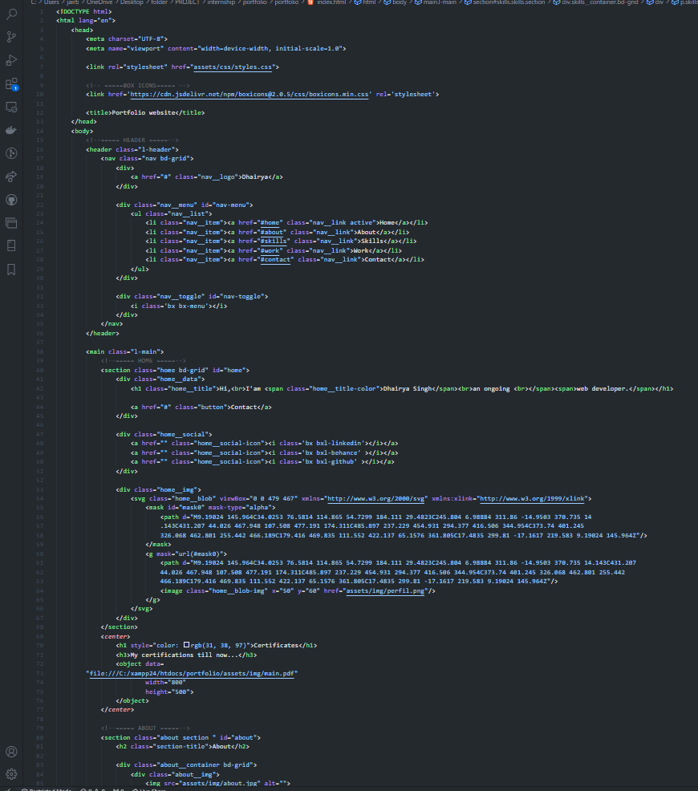
Portfolio code:

Slide 21
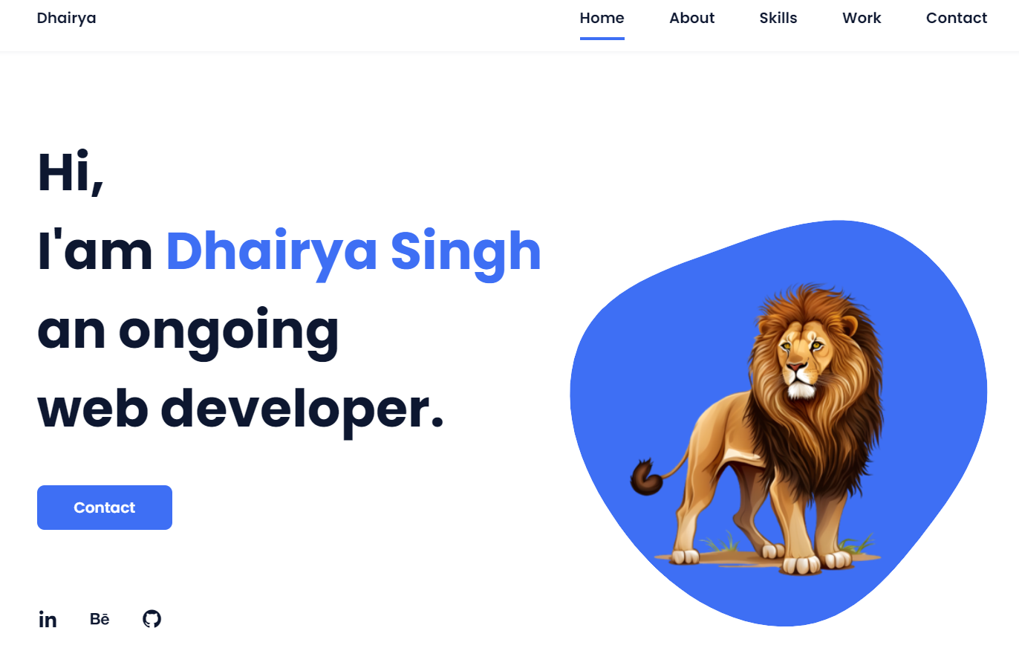
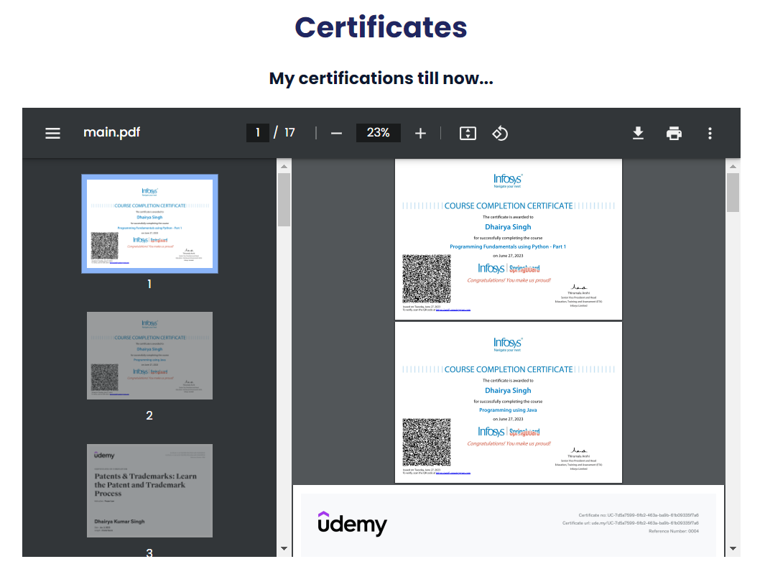
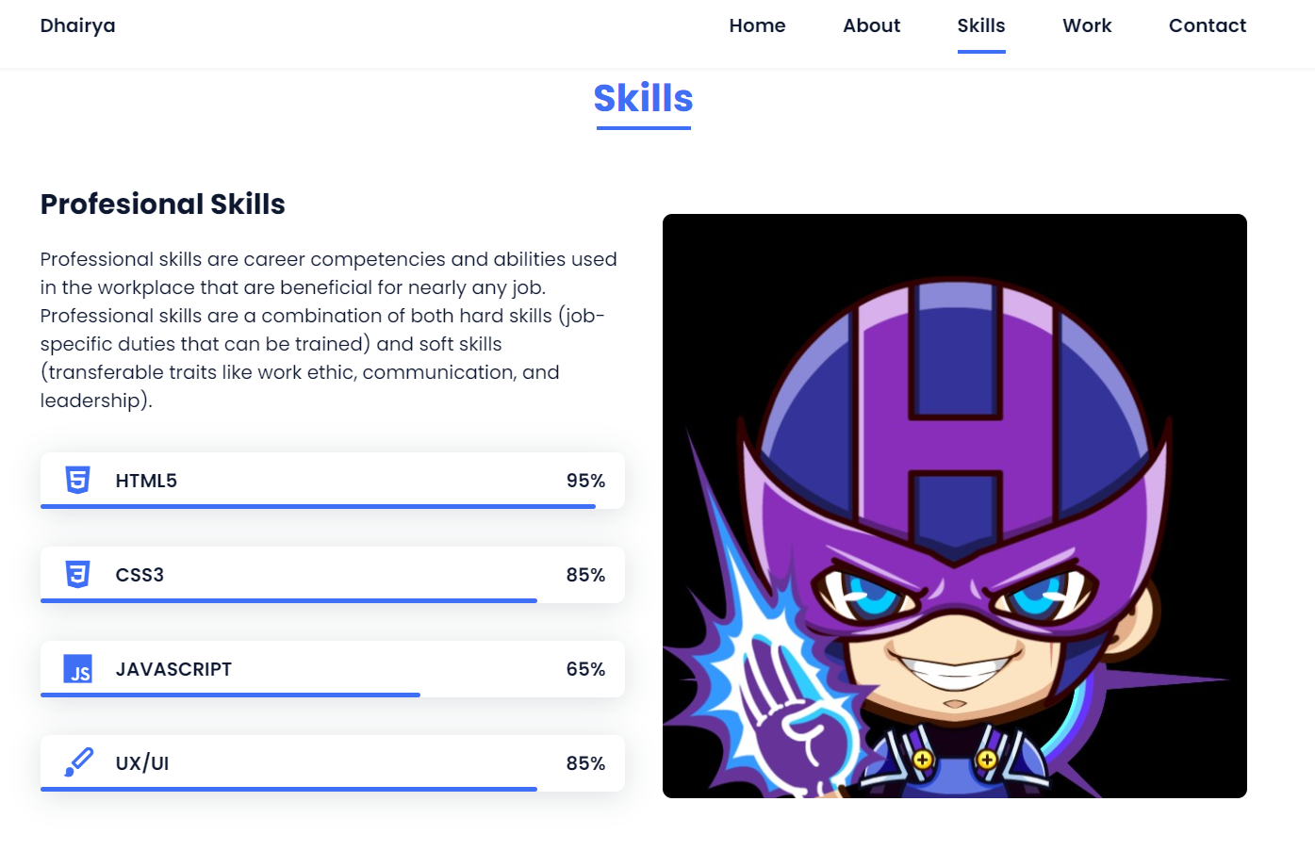
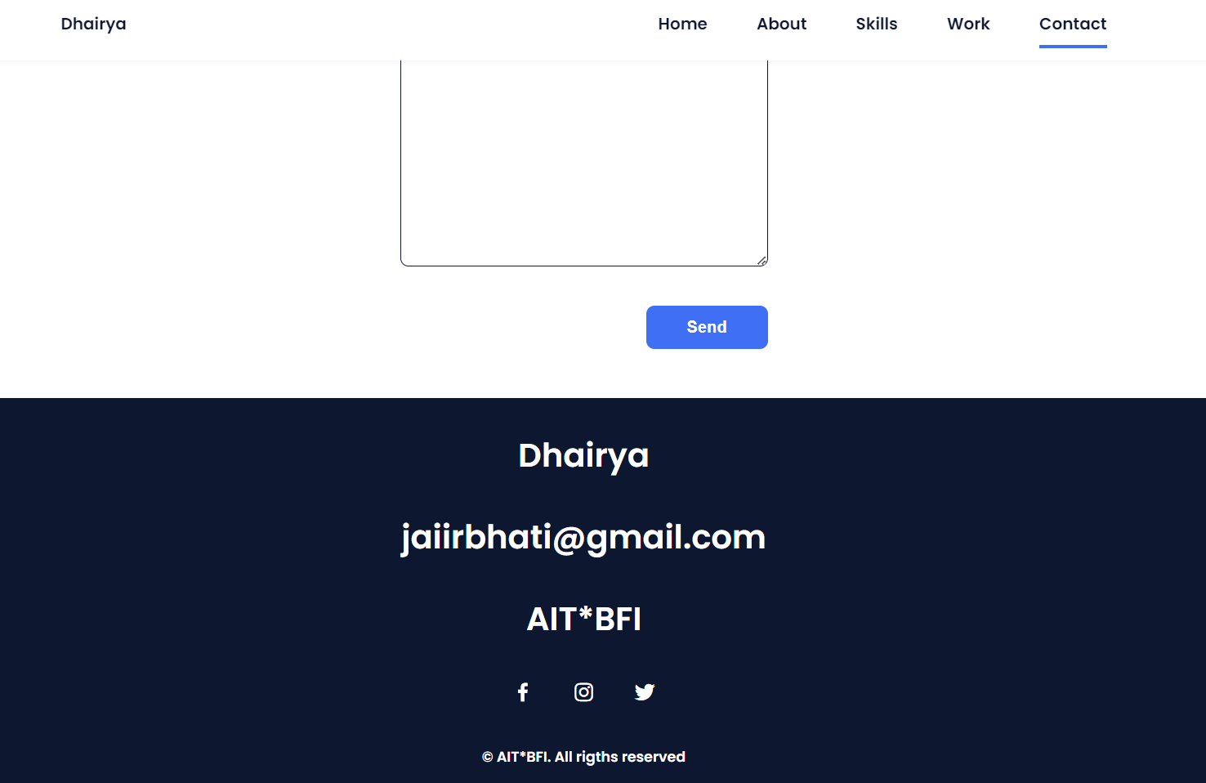
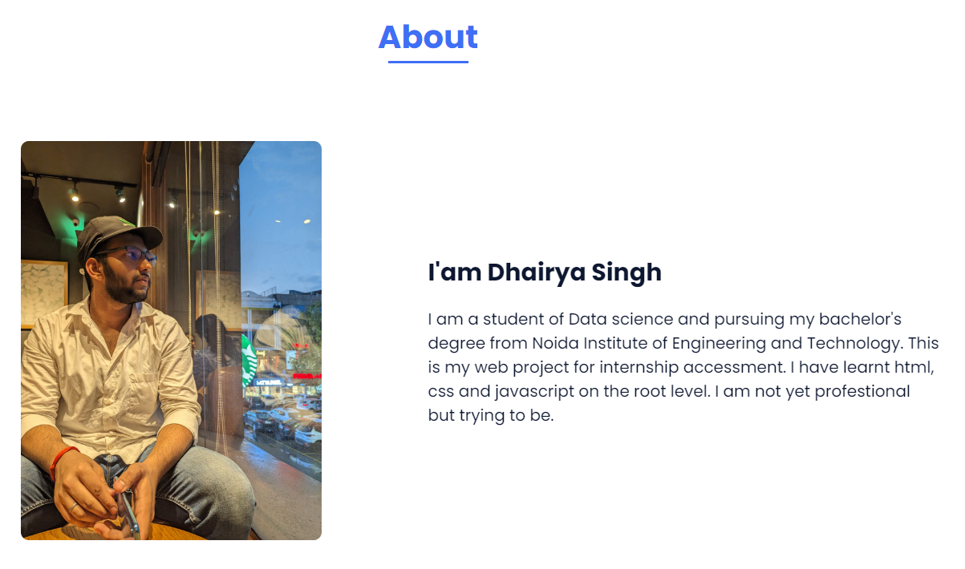

Slide 22
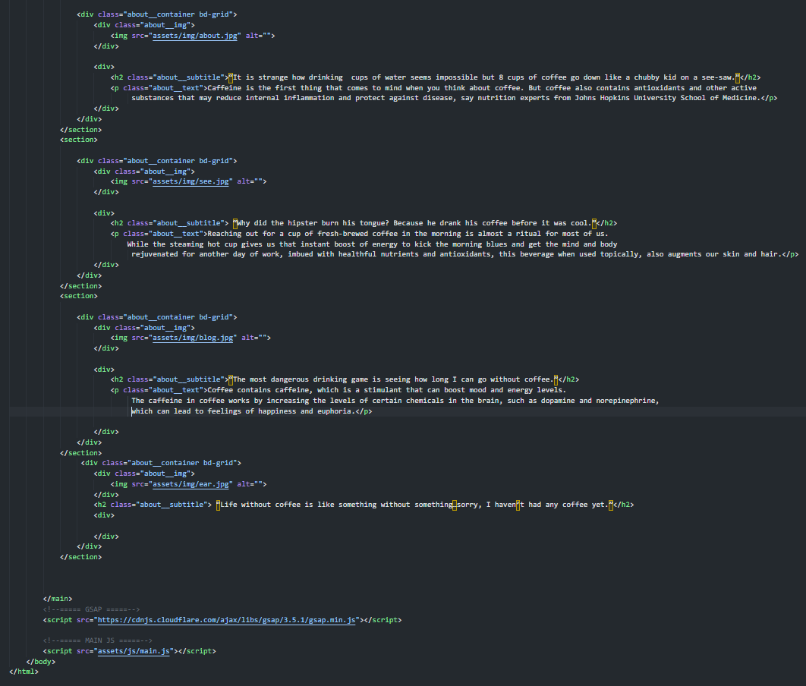
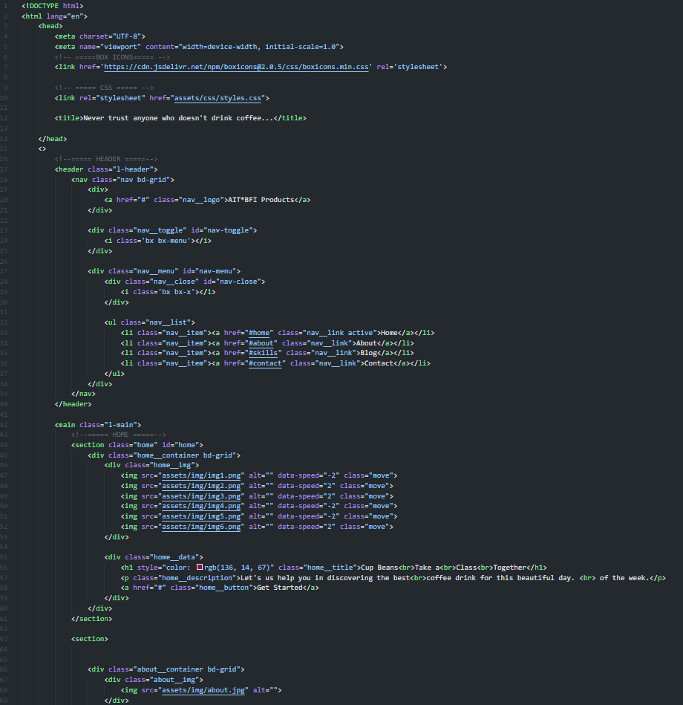
Landing page code:

Slide 23

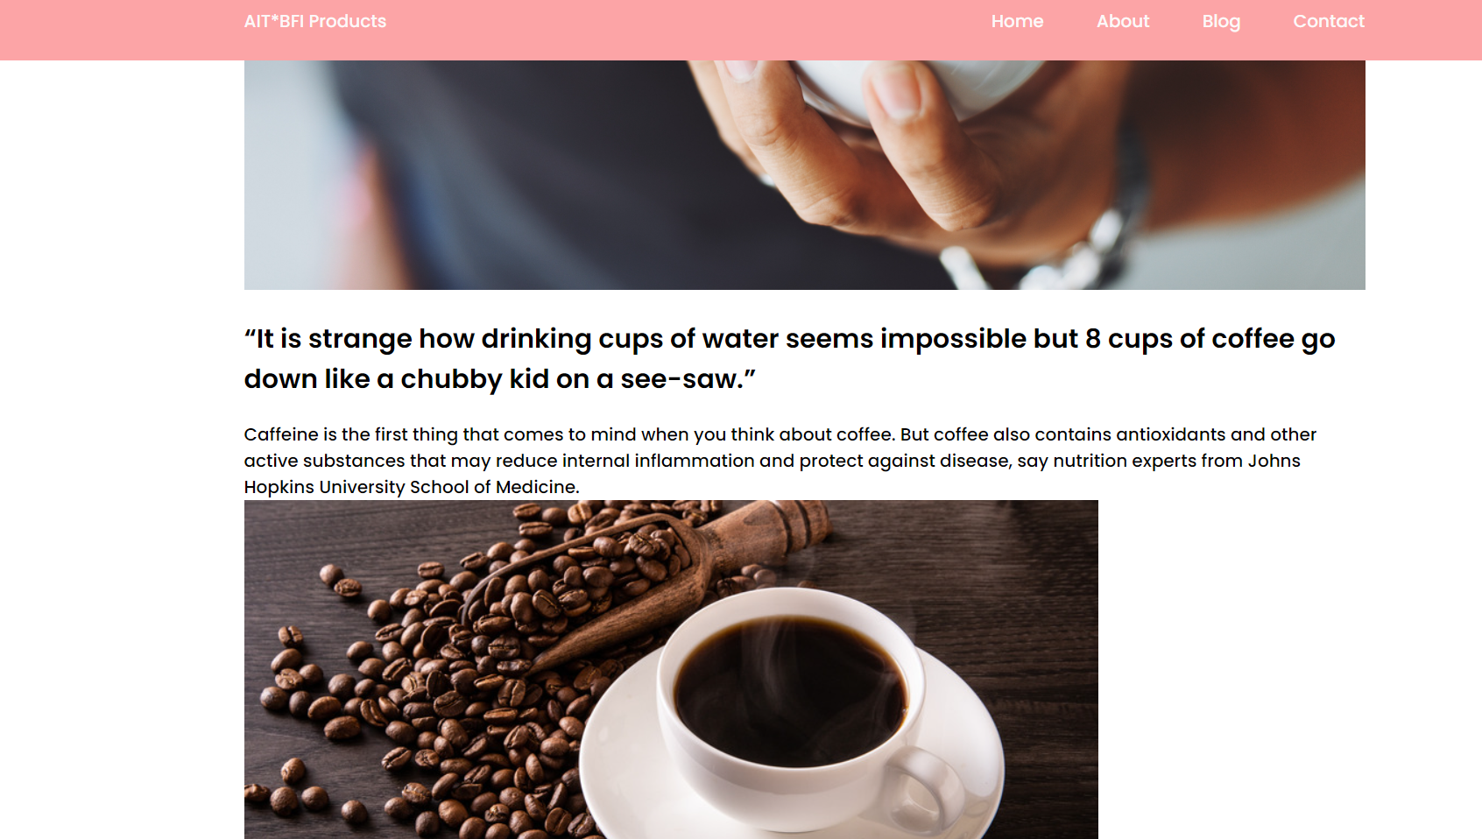
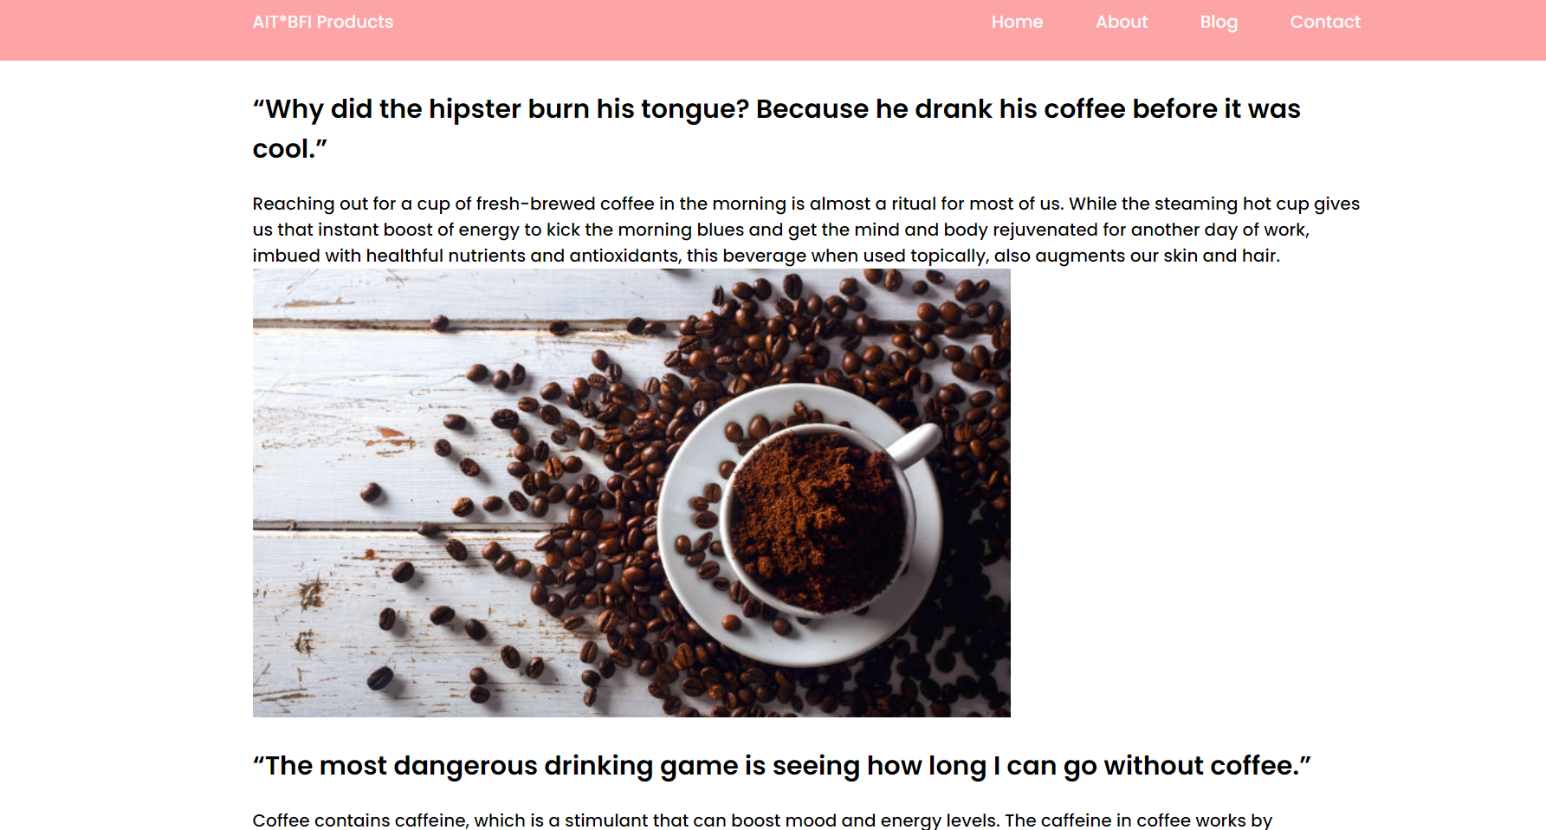
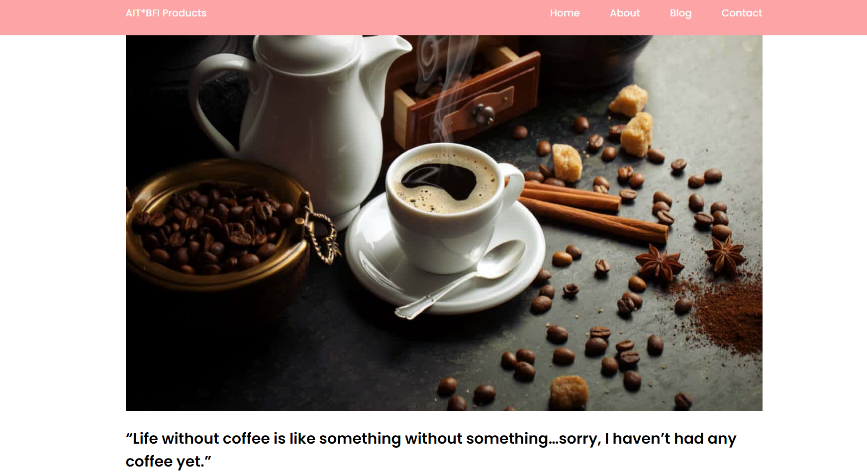

Slide 24
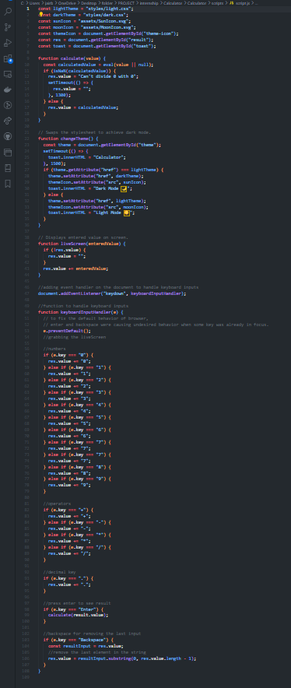
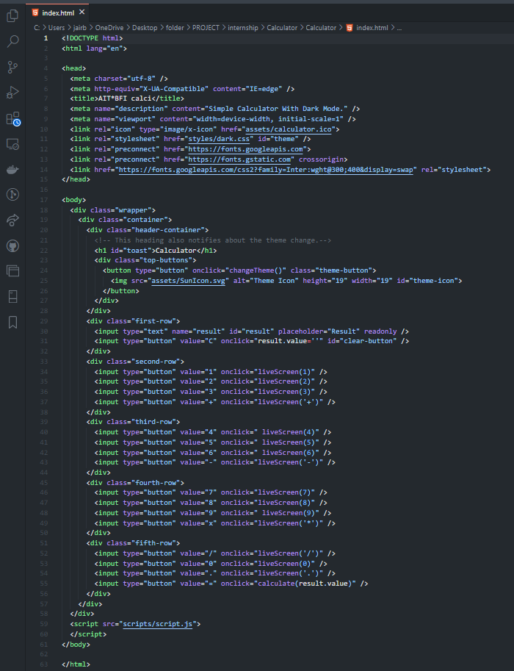
Calculator code:

Slide 25
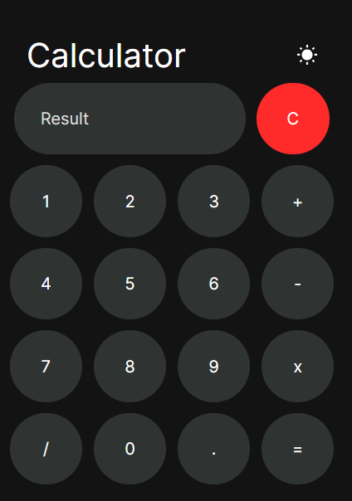
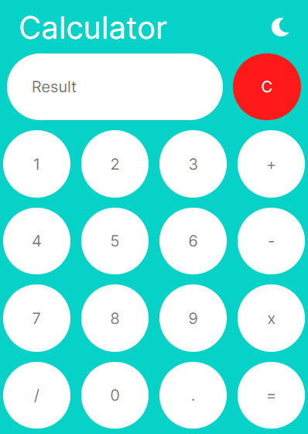
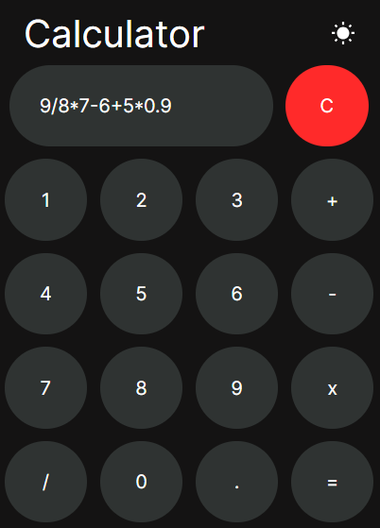
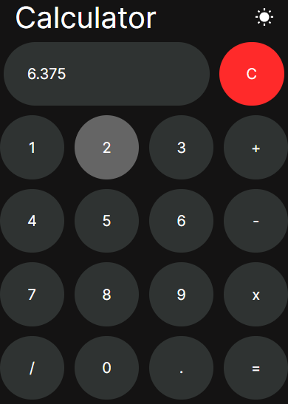

Slide 26

Summary
I have tried my best to learn most out of this internship assessment. Infect, I have gained confidence in using HTML, CSS and JavaScript. I Have completed this learning process to my full potential. This learning journey is enjoyable as well as knowledgeable. Web development is such a great skill to learn.

Slide 27

Thank you…
Dhairya Singh
2101331540036
CSE(DS)

